Slide 1
Interview
RIGHT
PRESS THE RIGHT KEY TO CONTINUE

Slide 2
[Experimenter: complete the interview now]
PRESS THE RIGHT KEY WHEN FINISHED

Slide 3
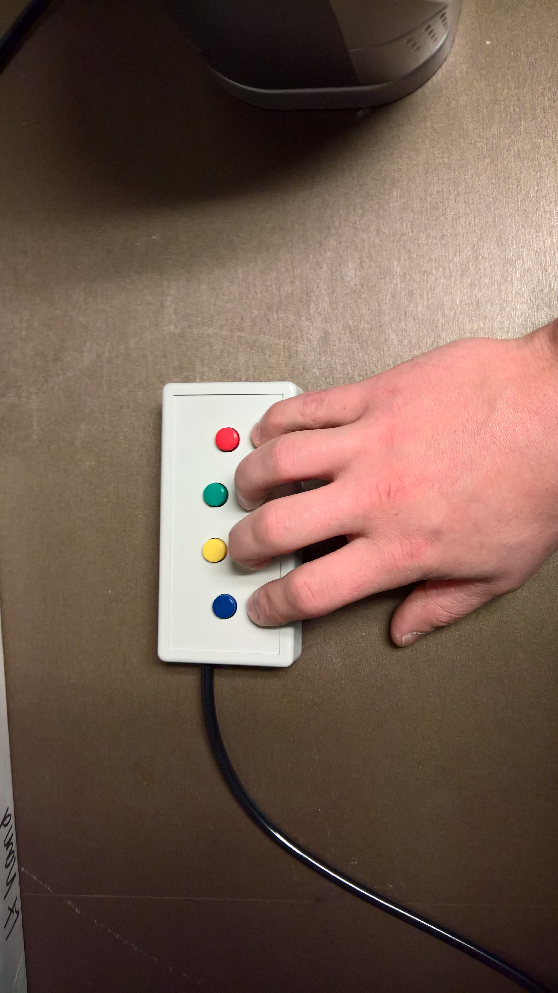
Please press the 1 button
1
2
3
4
PRESS 1 TO MOVE ON

Slide 4
Please press the 2 button
1
2
3
4
PRESS 2 TO MOVE ON

Slide 5
Please press the 3 button
1
2
3
4
PRESS 3 TO MOVE ON

Slide 6
Please press the 4 button
1
2
3
4
PRESS 4 TO MOVE ON

Slide 7
Social Evaluation Task
ONE
PRESS THE ONE BUTTON TO CONTINUE

Slide 8
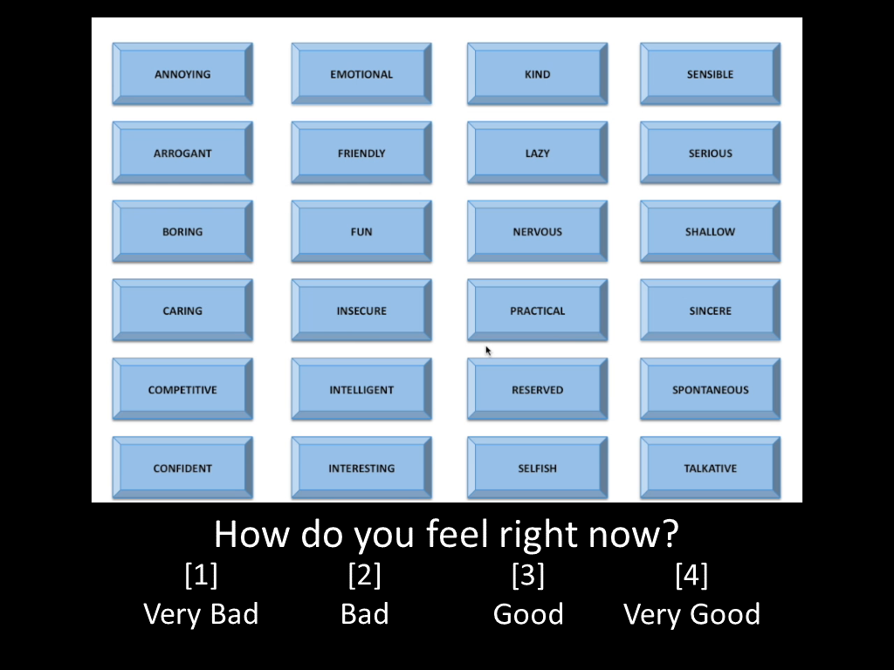
During this task, the other participant will use a screen like the one shown above to select adjectives describing you.
ONE
PRESS THE ONE BUTTON TO CONTINUE

Slide 9
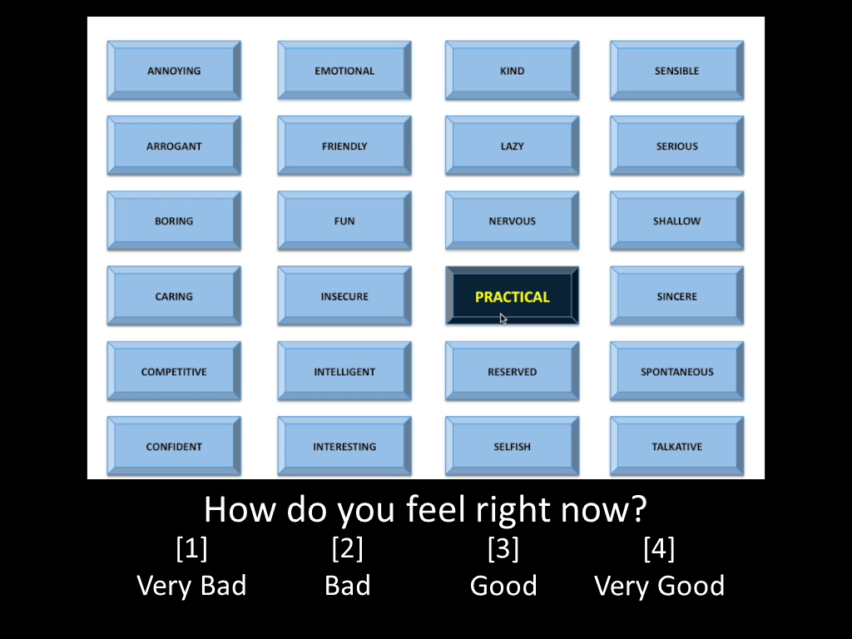
For example, if he/she thinks you are “PRACTICAL”, the screen would look like this.
ONE
PRESS THE ONE BUTTON TO CONTINUE

Slide 10

When the other participant selects an adjective, we would like you to press a button describing how you feel.
ONE
PRESS THE ONE BUTTON TO CONTINUE

Slide 11
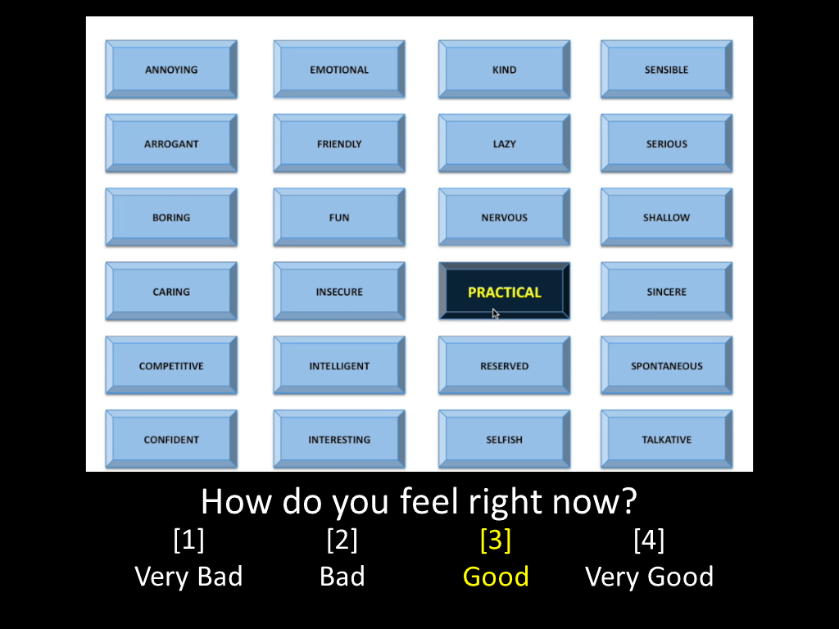
If you felt “Good” after the other participant described you as “PRACTICAL”, you would press the 3 button and it would look like this.
ONE
PRESS THE ONE BUTTON TO CONTINUE

Slide 12
Remember, the other participant will not see your responses.
ONE
PRESS THE ONE BUTTON TO CONTINUE
Notes:
Inside the scanner

Slide 13
Press the ONE button when you are ready to begin
ONE
PRESS THE ONE BUTTON TO CONTINUE
Notes:
Inside the scanner

Slide 14
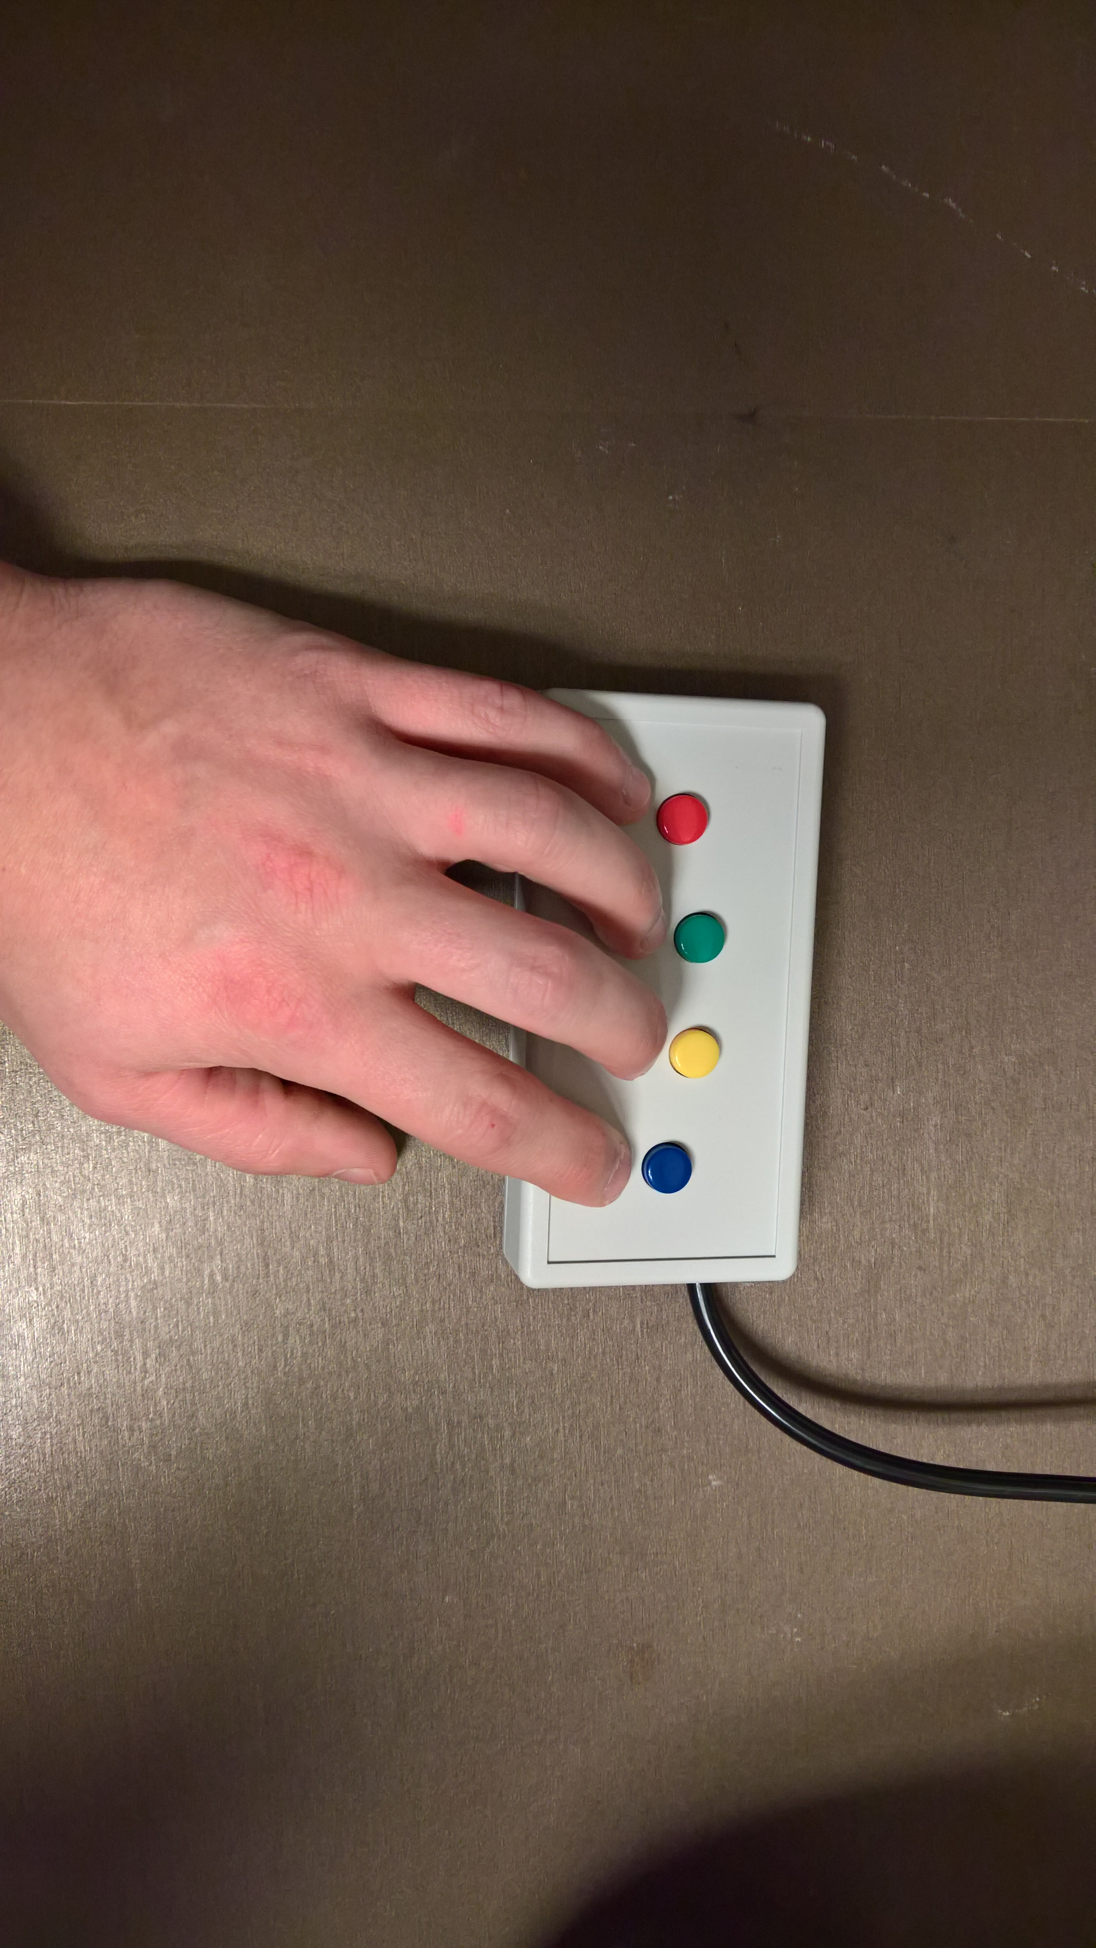
Please press the 4 button
1
2
3
4
PRESS 4 TO MOVE ON

Slide 15
Please press the 3 button
1
2
3
4
PRESS 3 TO MOVE ON

Slide 16
Please press the 2 button
1
2
3
4
PRESS 2 TO MOVE ON

Slide 17
Please press the 1 button
1
2
3
4
PRESS 1 TO MOVE ON

Slide 18
Social Evaluation Task
FOUR
PRESS THE FOUR BUTTON TO CONTINUE

Slide 19
During this task, the other participant will use a screen like the one shown above to select adjectives describing you.
FOUR
PRESS THE FOUR BUTTON TO CONTINUE

Slide 20
For example, if he/she thinks you are “PRACTICAL”, the screen would look like this.
FOUR
PRESS THE FOUR BUTTON TO CONTINUE

Slide 21
When the other participant selects an adjective, we would like you to press a button describing how you feel.
FOUR
PRESS THE FOUR BUTTON TO CONTINUE

Slide 22
If you felt “Good” after the other participant described you as “PRACTICAL”, you would press the 3 button and it would look like this.
FOUR
PRESS THE FOUR BUTTON TO CONTINUE

Slide 23
Remember, the other participant will not see your responses.
FOUR
PRESS THE FOUR BUTTON TO CONTINUE
Notes:
Inside the scanner

Slide 24
Press the FOUR button when you are ready to begin
FOUR
PRESS THE FOUR BUTTON TO CONTINUE
Notes:
Inside the scanner

